Slide 1



Real-Time Price Discovery and Volume Management at e-Marketplaces

Slide 2



The Team
Deeksha Das Mohapatra
Prakruthi B Gowda
Alamelu

Slide 3












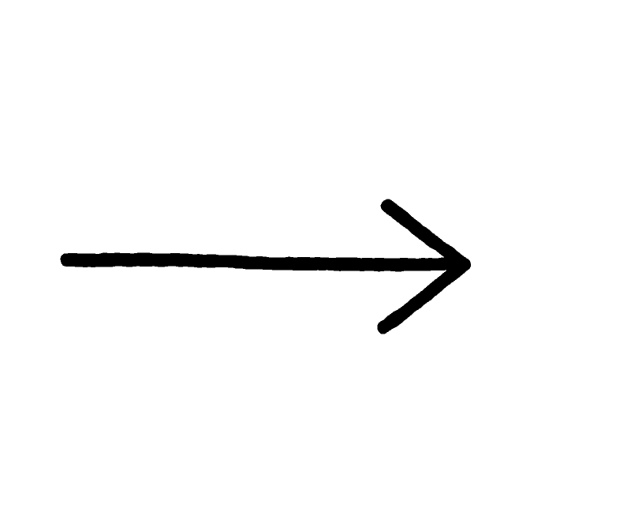
The Project Pipeline
Database
Preprocessing Cleaning and Feature selection
EDA
Data Reading
Model Building
Monitoring and evaluation
Raw Data
Cleaned and Structured Data
Success
IDE
Deployment

Slide 4


Table of Contents
Data Preprocessing
Introduction
Analysis
Conclusion
Aim and the Business Problem
Data Collection
Data Preparation
EDA
Model: ML & DL
The Result and Product

Slide 5

Introduction!
The Aim and The Business Problem

Slide 6
Aim
The Agricultural market cannot just be explained by the simple principle of supply and demand. Rather, it is an interplay of many variables that ideally should be used in the price-discovery of crops.
Post-harvest, farmers generally rely on the local prices set at mandis/marketplaces to sell their crops. It has been witnessed that using historical and real-time data, machine learning models could be built to predict real-time prices and also help manage crop volume.

Slide 7
Aim
Our aim is to build a model and a easy to use application on real-time price discovery and volume management at e-marketplaces in the Agriculture sector such that it becomes easier for the harvesters in anticipating their performance.
Hence, we present you with a dataset on agriculture around Telangana from the year 2016 to 2020 along with an additional record of the year 2021’s until the month of February and the key objective is to understand the forecasting trend in APMC (Agricultural produce market committee)/mandi price (Minimum, Maximum and Modal) & quantity arrival data for different commodities in Telangana.

Slide 8
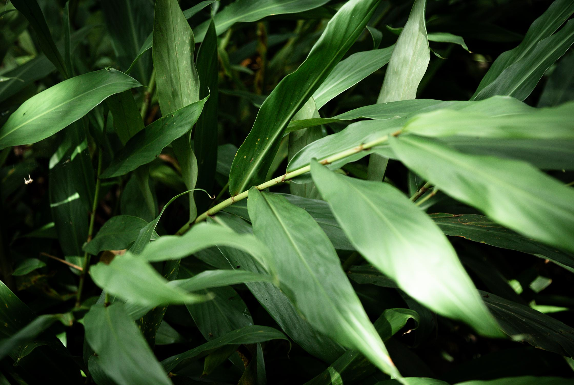
Business Problem
Farmers usually rely on the local prices at Mandis/Market to sell their crops, Hence,
The objective is to Maximize profits for the cultivator and help them in Volume management of crops
Business Constraints is to minimize the problems in increasing crop productivity by alerting the cultivators about the predicted production amount.

Slide 9
About!
Data Collection
The Data Description
Data Preparation

Slide 10

About
Data Collection
Data related to Market prices collected from the Telangana Govt website for the crops – Groundnut, Bengal gram and Maize. Link Courtesy: http://tsmarketing.in/AMCwiseStaffParticulars.aspx
Later we have made a connection to MySQL Database using Python such that it can capture the data stored in the database.

Slide 11
About
Data Collection
The data was available from 2012 to 2021. As 2012 to 2015 there were very few entries and entries were not available for all markets, data from 2016 to 2020 was considered. (b) There are a total of 75 Market Names

Slide 12
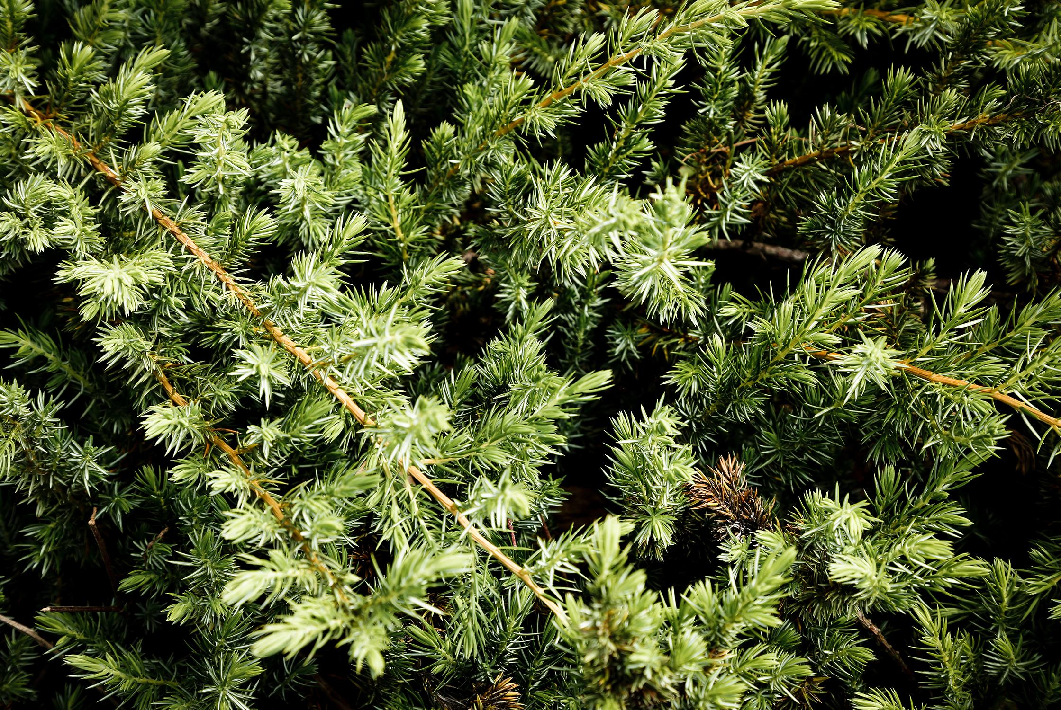
The APMCs
Mahbubnagar , Wanaparthy Town , Warangal , Narsampet , Siddipet , Makthal , Narayanpet, Suryapet , Jammikunta , Atmakur , Gollapalli , Jogipet , Siddipeta , Bhongir , Gadwal , Badepally , Choppadandi , Jangoan , Karimnagar , Mahabubabad , Gajwel , Kesamudram , Kollapur , Nagarkurnool , Thirumalagiri , Nizamabad , Achampet , Pargi , Shadnagar , Khammam , Jagtial , Sadasivpet , Zaheerabad , Vikarabad , Gangadhara , Kamareddy , Kalwakurthy , Tandur , Pitlam , Bicknoor , Ghanpur , Bowenpally , Mallapur , Husnabad , Medipally , Nekkonda , Ibrahimpatnam(JGL) , Marpally , Sardarnagar , Navabpet , Dharur , Gandhari , Wanaparthy Road , Devarakadra , Bhainsa , Pebbair , Vatpally , Korutla , Kulkacherla , Narayankhed , Sarangapur , Nirmal , Khanapur , Adilabad , Bhainsaa , Armoor, Alampur , Shankerpally , Bodhan , Kubeer , Dharmaram , Birkur , Metpally , Dharmapuri , Vantimamidi

Slide 13
Data Preprocessing
Data Dictionary
Date: The time series data of arrivals of collected crops
Amc_Name: The Market Names all over Telangana
Crop: The crop name
Volume: The crop volume in Quintals
Maximum: sum of Maximum price of arrived crops on the respective dates ;
Minimum: sum of Minimum price of arrived crops on the respective dates
Modal: Average price of arrived crops on the respective dates

Slide 14


Crops - Commodities
Groundnut
Maize
Bengal Gram
'Maize-Common’,
'Maize-Hybrid Old’ &
'Maize-Hybrid New'
'Groundnut pods-Common’ & 'Groundnut pods-Wet'
'Bengal Gram-Common'

Slide 15
Data Reading
We channelize the raw data to MySQL where the data is stored. Doing so helps us in future use.
Later we made a MySQL connection to our python editor for the implementation and to import our data
However, the data used for EDA in Tableau includes the direct Raw data for initial explanation of the data

Slide 16

Data Preparation
Transformation using MinMaxScaler
Transformation using Label Encoding
Data
Removal of NA’s
Removal of Outliers

Slide 17

Insights from the data
0.14%
0.075%
51%
Missing Values
Outliers were observed on the complete data – Incorrectly collected data
“Maize common” is having the highest Production

Slide 18
Analysis!
EDA
Model Building: ML and DL Approach

Slide 19
1. Tableau: EDA

Slide 20
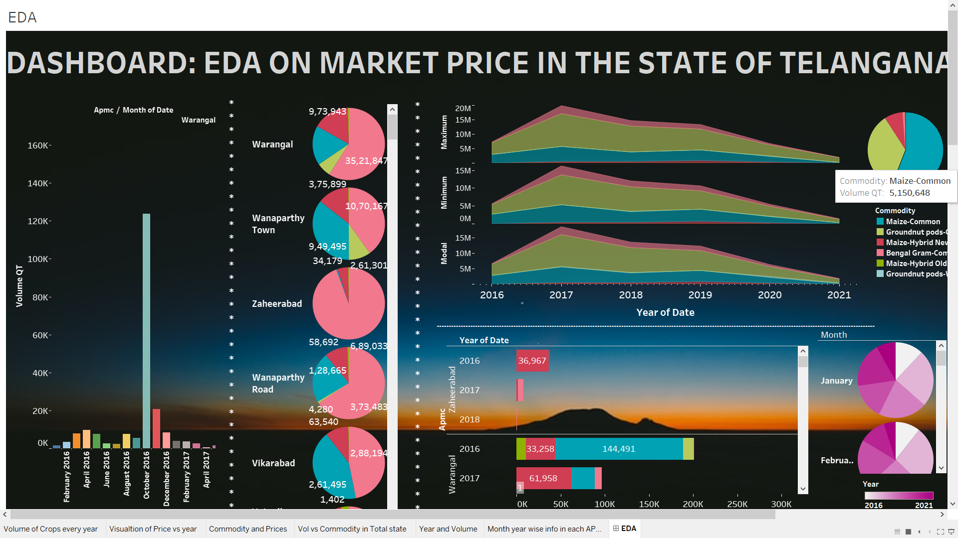

Slide 21
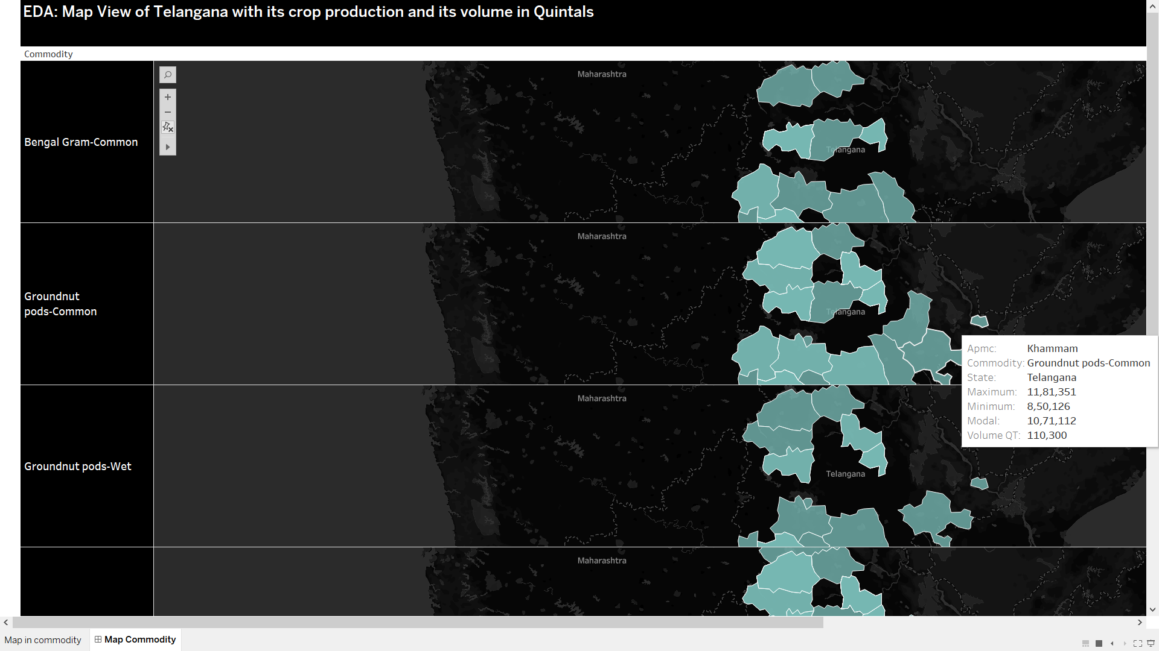
EDA: Map View of Telangana with its crop production and its volume in Quintals

Slide 22
1.1 Forecasting

Slide 23
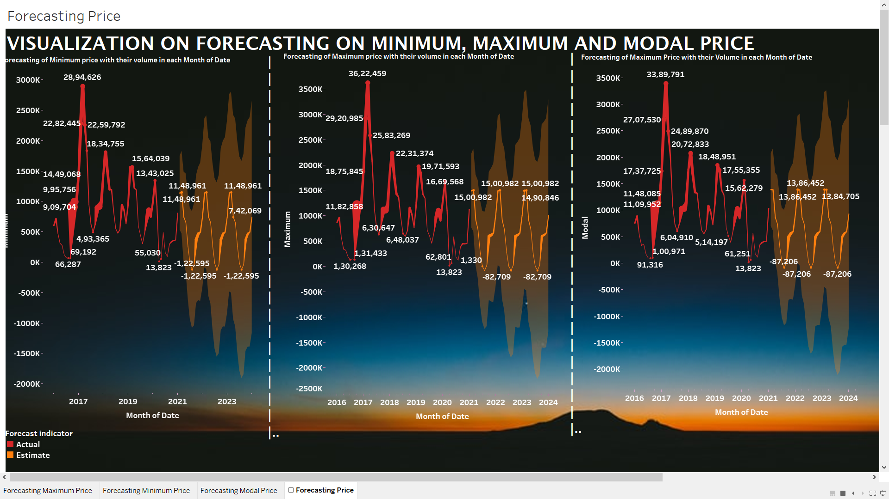
The Forecasting: minimum, maximum and modal price of different crops with their production volumes in quintals.

Slide 24
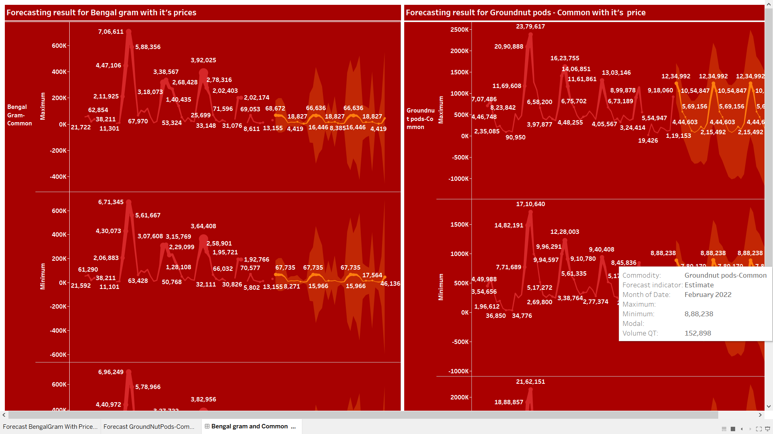
The Forecasting: Bengal Gram Common and Groundnut pods Common

Slide 25
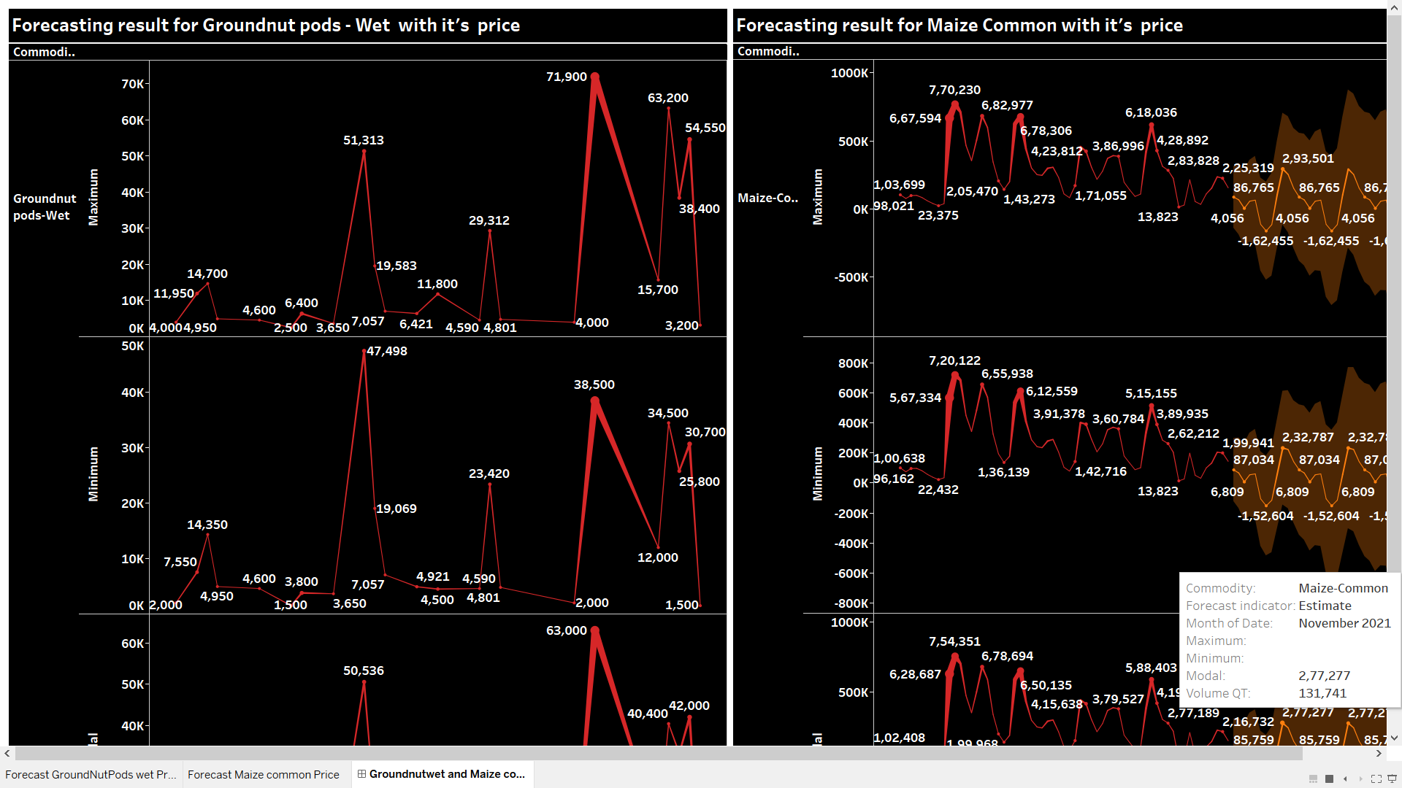
The Forecasting: Forecasting of Groundnut pods wet and Maize Common with their prices

Slide 26
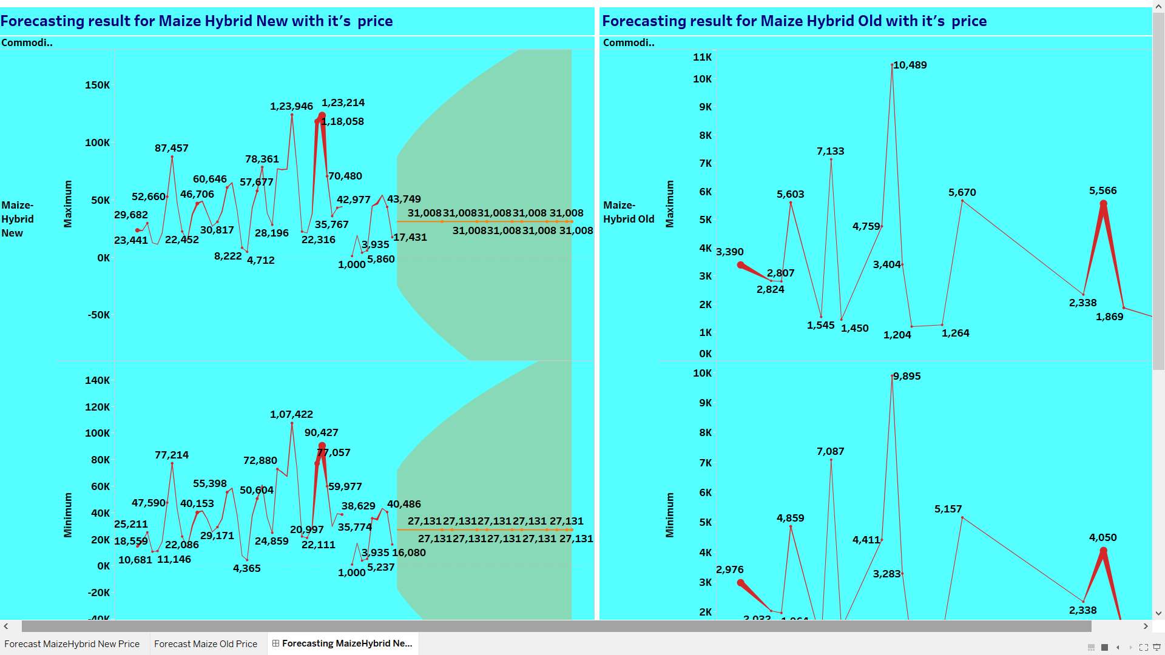
The Forecasting: Forecasting of Maize Hybrid New and Maize Hybrid Old

Slide 27
Model Selection
The Analysis on Tableau revealed that working on Forecasting technique will definitely lead to an unexpected Accuracy on our model. Hence, we further choose to work and experiment on random forest and other Machine learning techniques. We finally decided on Deep learning technique “LSTM” as it helped us obtain a good accuracy rate.

Slide 28
Model Building
As the business objective is to perform real-time price discovery, it was decided to build an LSTM model as it would keep into account the previous historical data as well while predicting. The date column would not be needed in this case, so it was ignored. The Crop and APMC columns were categorical data so Label Encoding was done for these 2 columns to convert them into numerical data.
After that, these 2 columns of data along with the Minimum and Maximum values were used as the input features for the LSTM model with the Modal value as the target variable.
The model was built with 2 LSTM hidden layers – one with 20 neurons and the next with 15 neurons.

Slide 29

Results obtained from Model Building
Train Data | 97%
Validation Data | 93%
Evaluation Data | 96%

Slide 30
Conclusion!
Deployment of LSTM Model on to Android application

Slide 31

Mobile App
The Model built showed an accuracy of 97% on the train data and 93% on validation data and this model was deployed using flask and later on to an Android Application
Working Interface: The user has to choose the "AMC Name" and "Crop" in the drop-down menus along with giving the maximum and minimum prices as an input in order to predict the price. This will help the harvesters to track the predicted amount market-wise and commodity wise. This app was built using a web application integrated development environment originally provided by Google called "MIT App Inventor".

Slide 32
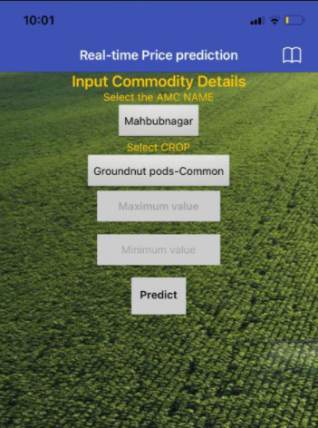
Preview: Mobile App
This application is built to overcome the complication of farmers in anticipating the future price of a commodity based on the overall volume production of each respective commodity during farming

Slide 33


Slide 34


